Slide 1
Microsoft Power BI

Slide 2
Report Authoring and Customization with Power BI Embedding
Ted Pattison
Principal Program Manager
Power BI Customer Advisory Team (PBICAT)

Slide 3
Welcome to Power BI Dev Camp
Power BI Dev Camp Portal - https://powerbidevcamp.net

Slide 4
Developer Sample: xxxx
You can download and try out the sample code used in this webinar
Implemented as C#/.NET6 web application which uses the Power BI .NET SDK
Download from

Slide 5
Agenda
Initializing and Customizing Report Pages
Creating Custom Navigation with Pages and Bookmarks
Creating Authoring Experiences with the Report Designer
Creating New Pages and Adding Visuals using Code
Embedding Reports using Custom Layouts
Adding Personalization Features using Custom Bookmarks

Slide 6
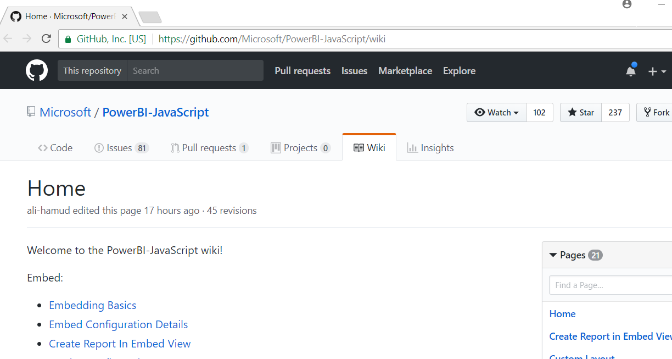
Power BI JavaScript API (powerbi.js)
Power BI JavaScript API used to embed resources in browser
GitHub repo at https://github.com/Microsoft/PowerBI-JavaScript/wiki
GitHub repository contains code, docs, wiki and issues list

Slide 7
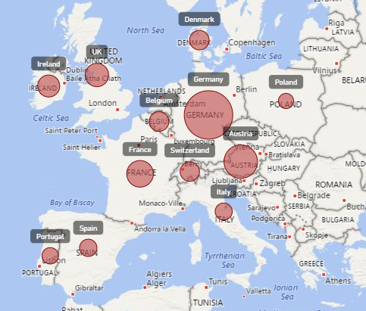
Report Embedding Architecture
Embedding involves creating an iFrame on the page
PBIJS transparently creates iFrame and sets source to Power BI Service
The iFrame and hosting page originate from different DNS domains
https://app1.mydomain.com
Your HTML and CSS
Web Hosting Server
Your
JavaScript
iFrame
Embedding Data
https://wabi-us-east2-redirect.analysis.windows.net/
powerbi.js
Power BI Service

Slide 8
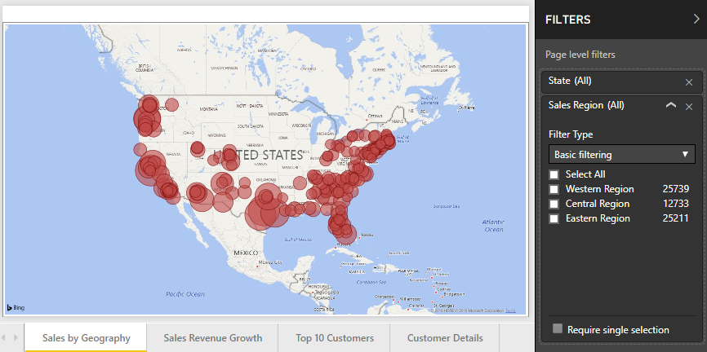
A Promise-based Programming Model
Design of PBIJS simulates HTTP protocol
Creates more intuitive programming model for developers
Programming based on asynchronous requests and promises
Embedded objects programmed using actions and events
Actions
report.fullscreen
report
report.switchMode
report.setFilters
Your
JavaScript
report.getPages
Events
report.loaded
report.pageChanged
report.commandTriggered

Slide 9
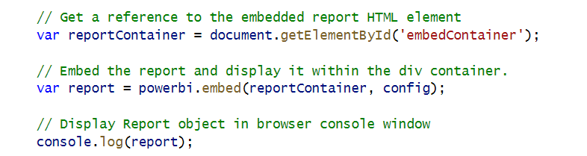
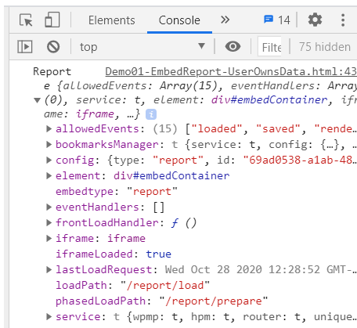
Viewing Report Object in Chrome Dev Tools

Slide 10
Custom Report Page Initialization
Navigation
View Scale Mode – Fit to Page | Fit to Screen | Actual size
Panes in View Mode

Slide 11
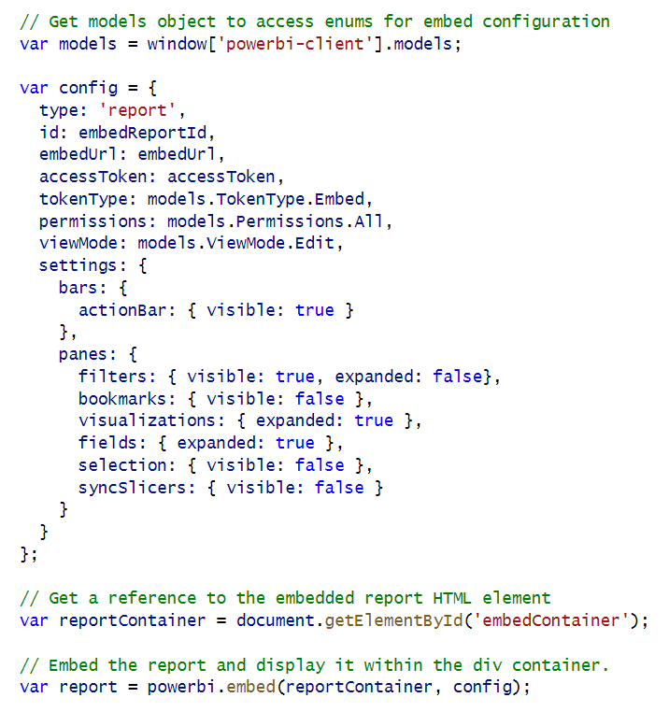
Report Panes

Slide 12
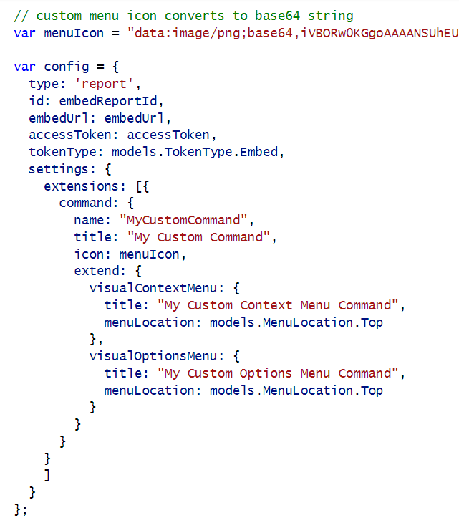
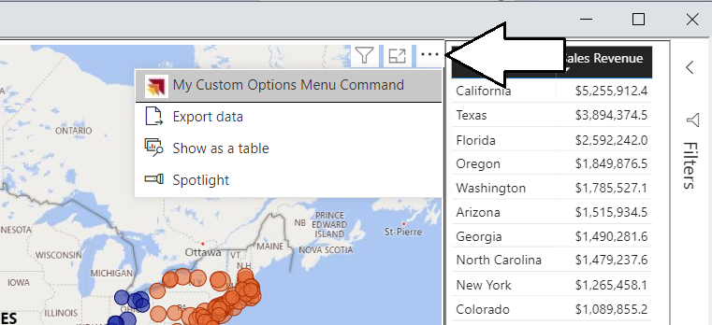
Adding Visual Menu Commands

Slide 13
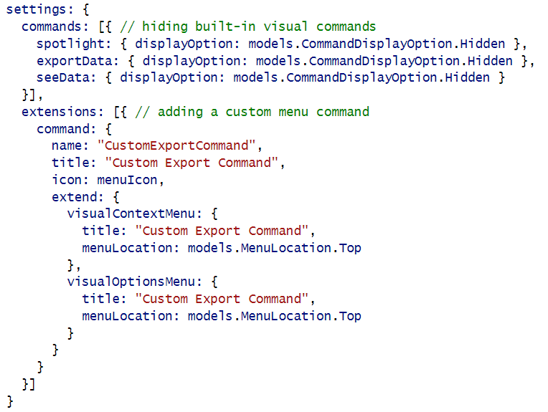
Hiding Built-in Visual Menu Commands

Slide 14
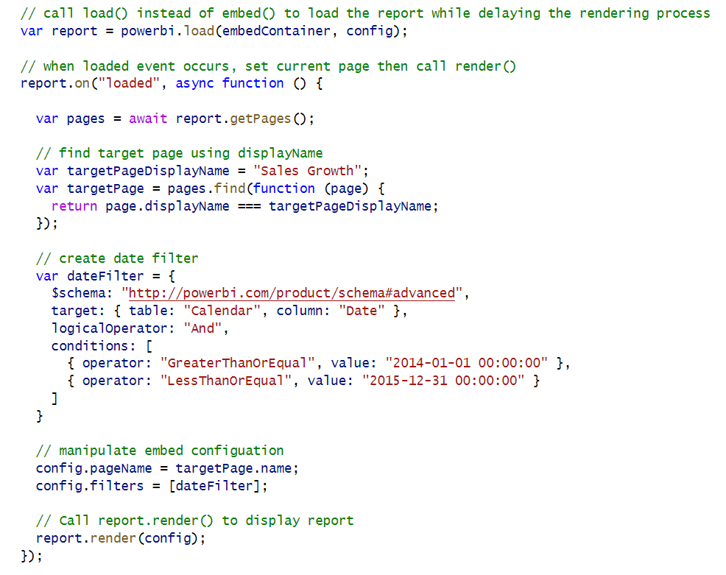
Phased Embedding

Slide 15
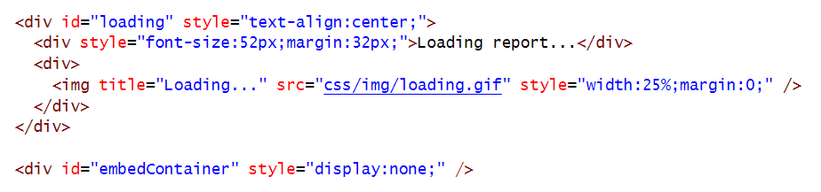
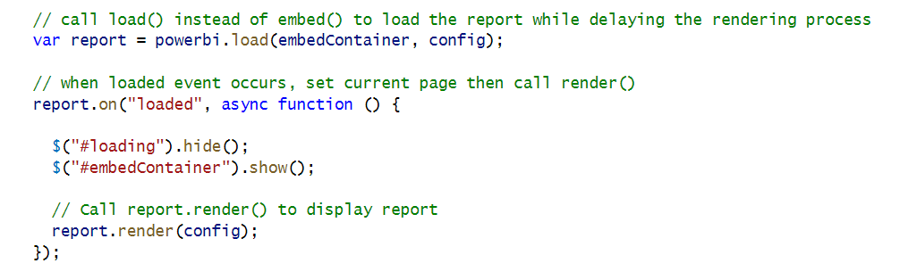
White Label Report Loading

Slide 16
Agenda
Initializing and Customizing Report Pages
Creating Custom Navigation with Pages and Bookmarks
Creating Authoring Experiences with the Report Designer
Creating New Pages and Adding Visuals using Code
Embedding Reports using Custom Layouts
Adding Personalization Features using Custom Bookmarks

Slide 17
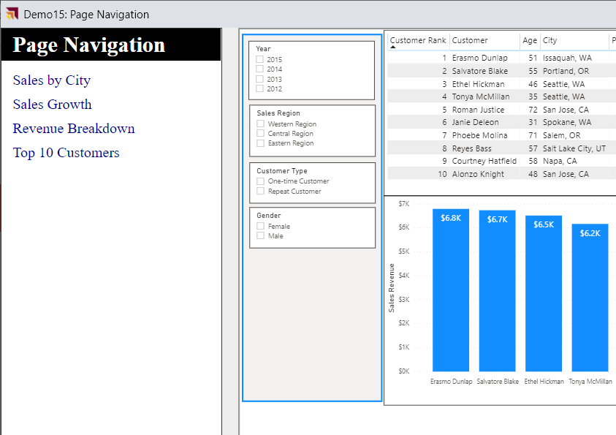
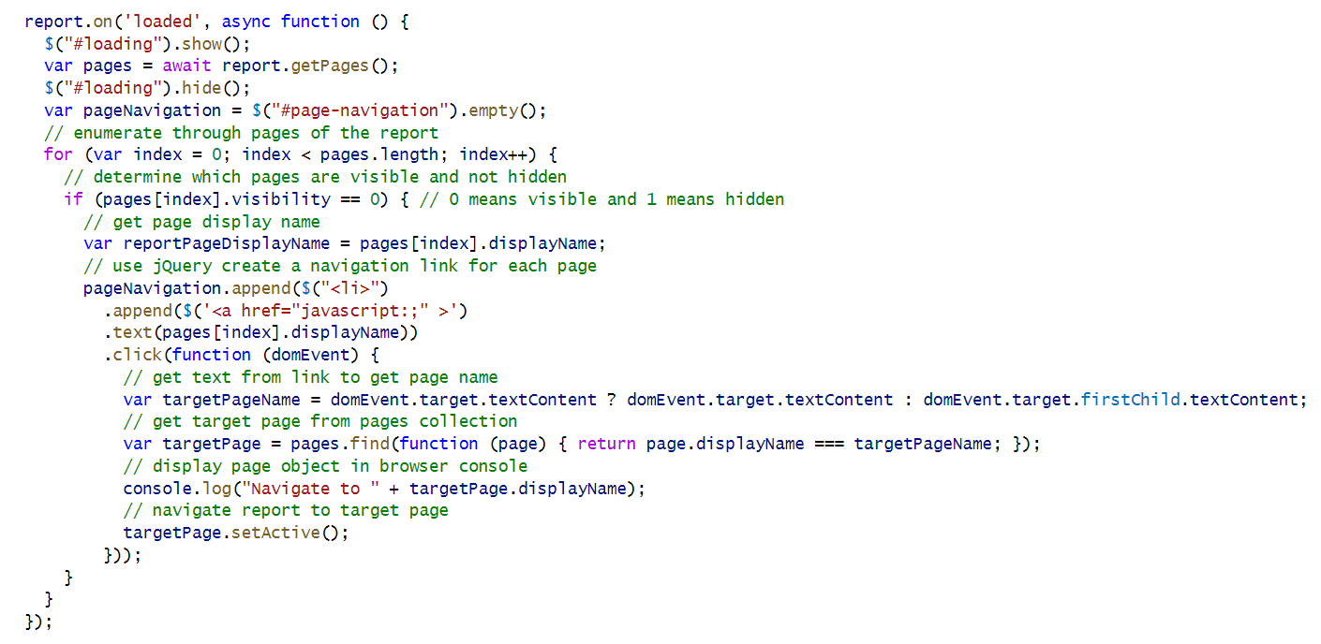
Custom Page Navigation

Slide 18
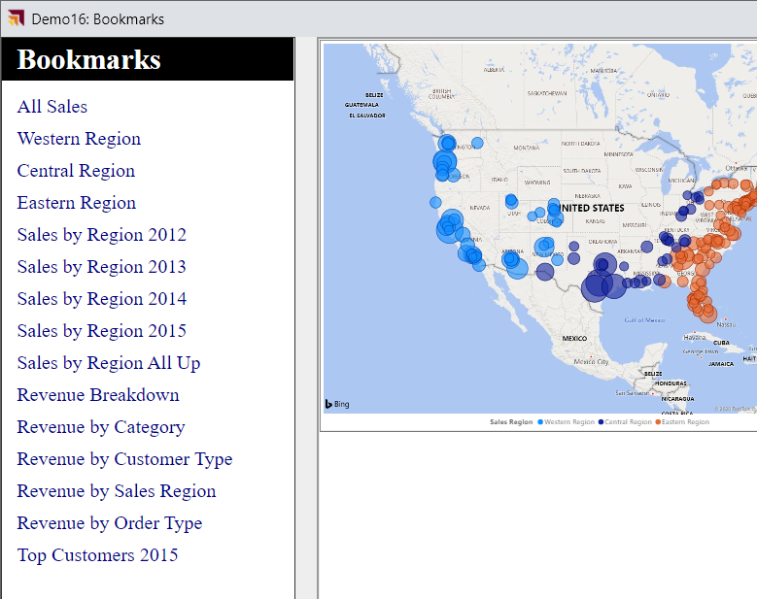
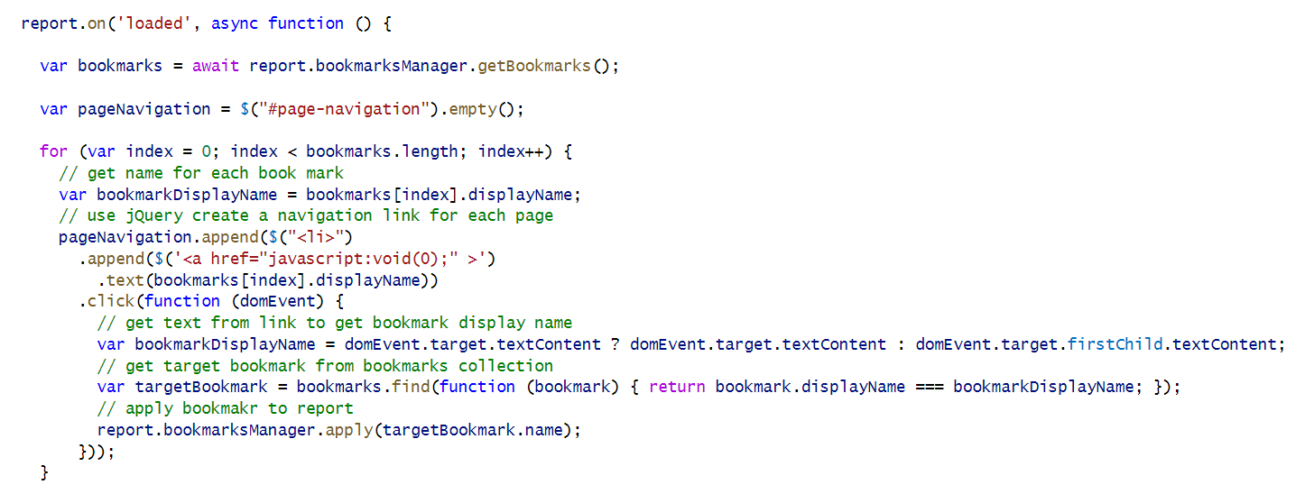
Custom Bookmark Navigation

Slide 19
Agenda
Initializing and Customizing Report Pages
Creating Custom Navigation with Pages and Bookmarks
Creating Authoring Experiences with the Report Designer
Creating New Pages and Adding Visuals using Code
Embedding Reports using Custom Layouts
Adding Personalization Features using Custom Bookmarks

Slide 20
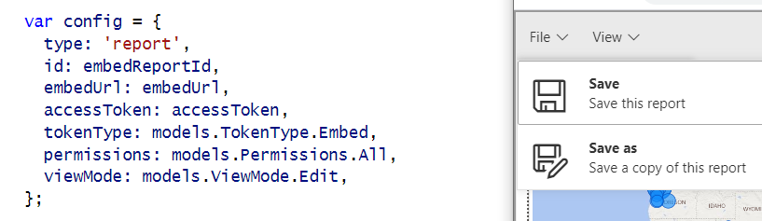
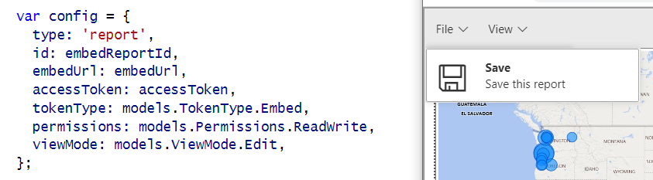
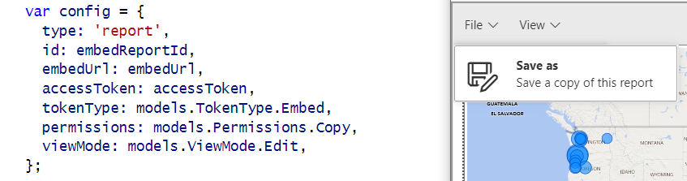
Showing and Hiding the Save and Save as Menus
permissions: models.Permissions.All
permissions: models.Permissions.ReadWrite
permissions: models.Permissions.Copy

Slide 21
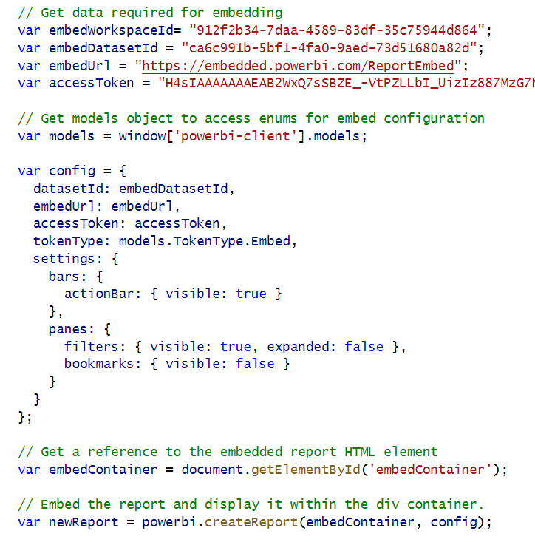
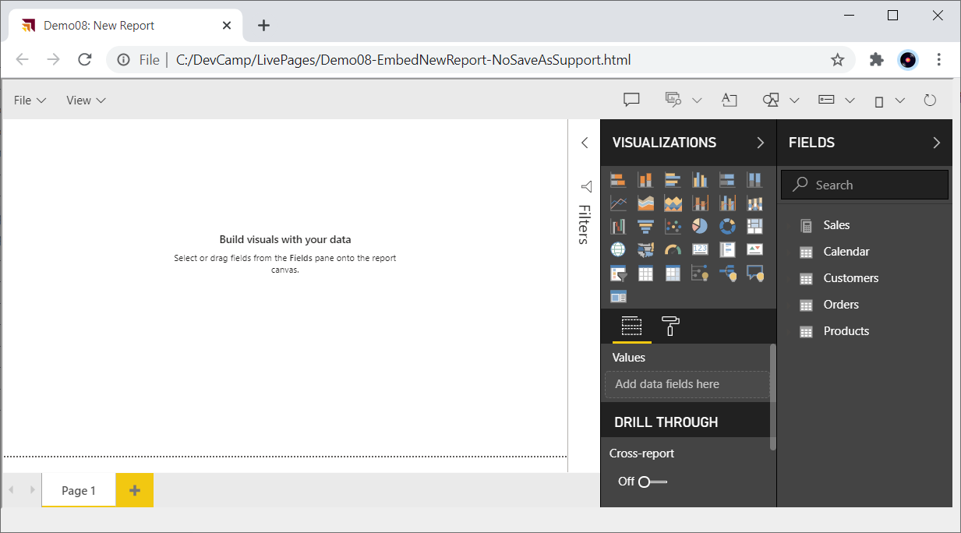
Embed a New Report

Slide 22
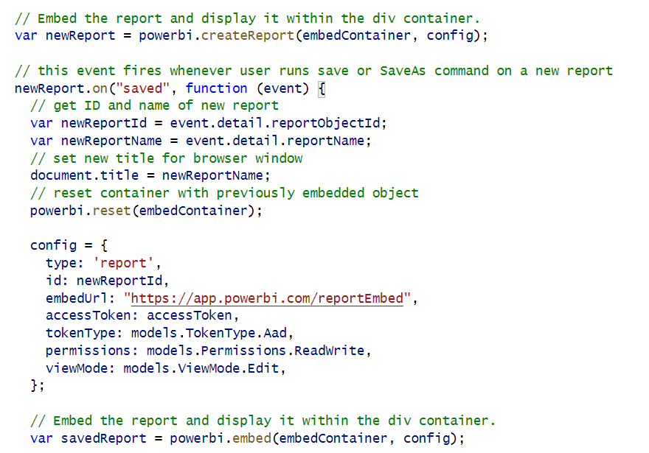
New Report with Save As Redirect

Slide 23
Agenda
Initializing and Customizing Report Pages
Creating Custom Navigation with Pages and Bookmarks
Creating Authoring Experiences with the Report Designer
Creating New Pages and Adding Visuals using Code
Embedding Reports using Custom Layouts
Adding Personalization Features using Custom Bookmarks

Slide 24
Visual Types Available for Programmatic Creation
xcccc
actionButton
areaChart
barChart
basicShape
card
clusteredBarChart
clusteredColumnChart
columnChart
debugVisual
Decomposition Tree
donutChart
esriVisual
filledMap
funnel
gauge
hundredPercentStackedBarChart
hundredPercentStackedColumnChart
image
keyDriversVisual
kpi
lineChart
lineClusteredColumnComboChart
lineStackedColumnComboChart
map
multiRowCard
pieChart
pivotTable
PowerApps
pythonVisual
qnaVisual
ribbonChart
scatterChart
scriptVisual
shapeMap
slicer
stackedAreaChart
tableEx
textbox
treemap
waterfallChart

Slide 25
Agenda
Initializing and Customizing Report Pages
Creating Custom Navigation with Pages and Bookmarks
Creating Authoring Experiences with the Report Designer
Creating New Pages and Adding Visuals using Code
Embedding Reports using Custom Layouts
Adding Personalization Features using Custom Bookmarks

Slide 26
Agenda
Initializing and Customizing Report Pages
Creating Custom Navigation with Pages and Bookmarks
Creating Authoring Experiences with the Report Designer
Creating New Pages and Adding Visuals using Code
Embedding Reports using Custom Layouts
Adding Personalization Features using Custom Bookmarks

Slide 27
Summary
Initializing and Customizing Report Pages
Creating Custom Navigation with Pages and Bookmarks
Creating Authoring Experiences with the Report Designer
Creating New Pages and Adding Visuals using Code
Embedding Reports using Custom Layouts
Adding Personalization Features using Custom Bookmarks

Slide 28
Microsoft Power BI
Questions?

